Slide 1
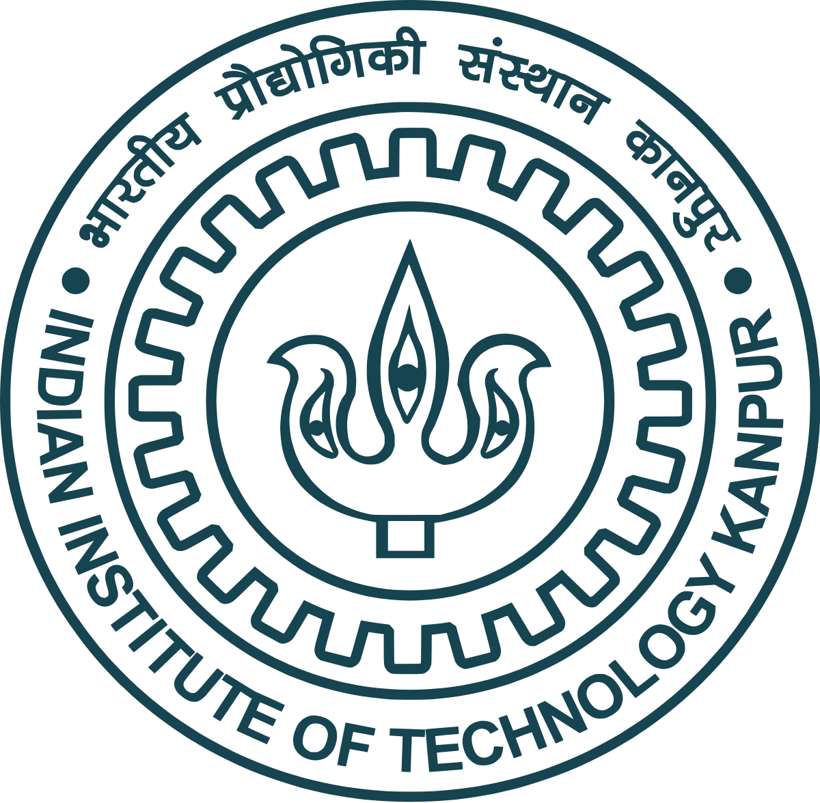

Lecture 1
Organic Chemistry: Fundamentals and Applications (CSO201A)
Dr. Srinivas Dharavath
Assistant Professor
Department of Chemistry
Indian Institute of Technology, Kanpur
Kanpur- 208016
E-mail: srinivasd@iitk.ac.in

Slide 2
First Course Handout for CSO201A
Class Timings: Friday 5.00-6.00 pm
Course Instructor: Dr. Srinivas Dharavath and Prof. D. H. Dethe
Course Email id: srinivasd@iitk.ac.in and ddethe@iitk.ac.in
Course Structure:
Sections: Basic Organic Chemistry Concepts: Chemistry in everyday life, introduction to organic molecules and functional groups understanding organic reactions (3 classes), stereochemistry and carbon- carbon bond forming reactions in organic synthesis (6 classes). Drugs some examples including love drugs and molecules of death (2 classes). Nomenclature of organic, heterocyclic compounds (2 classes). Reaction intermediates, substitution and elimination reactions (8 classes).

Slide 3
First Course Handout for CSO201A
CSO201A: Organic Chemistry: Fundamentals and Applications (3-0-0-9) No. of Lectures: 42
Dr. Srinivas Dharavath
No. of Lectures: 21
Basic Organic Chemistry Concepts: Chemistry in Everyday life, introduction to organic molecules and functional groups understanding organic reactions. intermediates, substitution and elimination reactions: (Ref: Reactive Intermediates in Organic Chemistry: Structure, Mechanism, and Reactions Book by Maya Shankar Singh, Organic Chemistry Sixth Edition, Janice Gorzynski Smith Chapter 1,3 and 6, Carey, Francis A.; Sundberg, Richard J.; (1984). Advanced Organic Chemistry Part A Structure and Mechanisms (2nd ed.). New York N.Y.: Plenum Press. March Jerry; (1885). Advanced Organic Chemistry reactions, mechanisms and structure (3rd ed.). New York: John Wiley & Sons, inc. GILCHRIST, T. L. (1966). (07) Nomenclature of organic and heterocyclic compounds (Ref: Nomenclature of Organic Chemistry Book by J. Rigaudy and S. P. Klesney) (06) Carbon- carbon bond forming reactions: (Ref: Sykes, Peter, A guide book to Mechanism in Organic Chemistry, R. Bruckner, Organic Mechanisms, 2010) (07)
Drugs some examples: (Ref: Announced later as multiple books will be followed) (01)

Slide 4
First Course Handout for CSO201A
Prof. D. H. Dethe
No. of Lectures: 21
Chemistry of odors, dyes and flavors. Green Chemistry introduction, principles, sustainability, atom economy, some green initiatives, management of resources and its effect on health and environment. Catalysis and biocatalysts in organic chemistry. Enantioselectivity and chiral-synthesis, organo-catalysis. Enzymes as drug targets and their inhibitors as model inhibitors. Solid phase synthesis and strategies for futuristic designs in organic chemistry. Photo-chemistry: simple concepts and applications (semiconductor photochemistry, solar energy conversion by photovoltaic cells, photo catalysis, etc.); supra molecular photochemistry. Organic Materials: polymers (biodegradable polymers, conducting polymers, etc.), smart materials, OLEDs, intelligent gels, dyes, etc
Books:
March, J., Advanced Organic Chemistry, 4th ed, 1999. Clayden, G., Warren, and Wothers, Organic Chemistry, 1st ed, 2001.
Nasipuri, D., Stereochemistry of Organic Compounds, 2nd ed., 1995.
Sykes, Peter, A guide book to Mechanism in Organic Chemistry, R. Bruckner, Organic Mechanisms, 2010.
Nomenclature of Organic Chemistry Book by J. Rigaudy and S. P. Klesney.
Reactive Intermediates in Organic Chemistry: Structure, Mechanism, and Reactions Book by Maya Shankar Singh.

Slide 5
First Course Handout for CSO201A
Exam Structure:
Exam papers will be evaluated and graded on a relative grading system
There will be 2-surprise quizzes (Q1 before Mid Sem and Q2 before End Sem), each of the quizzes will be for 25 marks each and for a total of 50 from both Q1&2.
Assignments will be given at any time. This will be 15 marks.
Mid Sem Exam: The syllabus portion will be mention accordingly in the class. This will hold a weight of 35 marks.
End Sem Exam: The complete portion of the syllabus will be included. This will be 50 marks.
All the exams will carry equal weightage. Therefore, marks scored out of a total of 150 will be converted into the percentage for the final grading.

Slide 6

Chemistry in everyday life

Slide 7
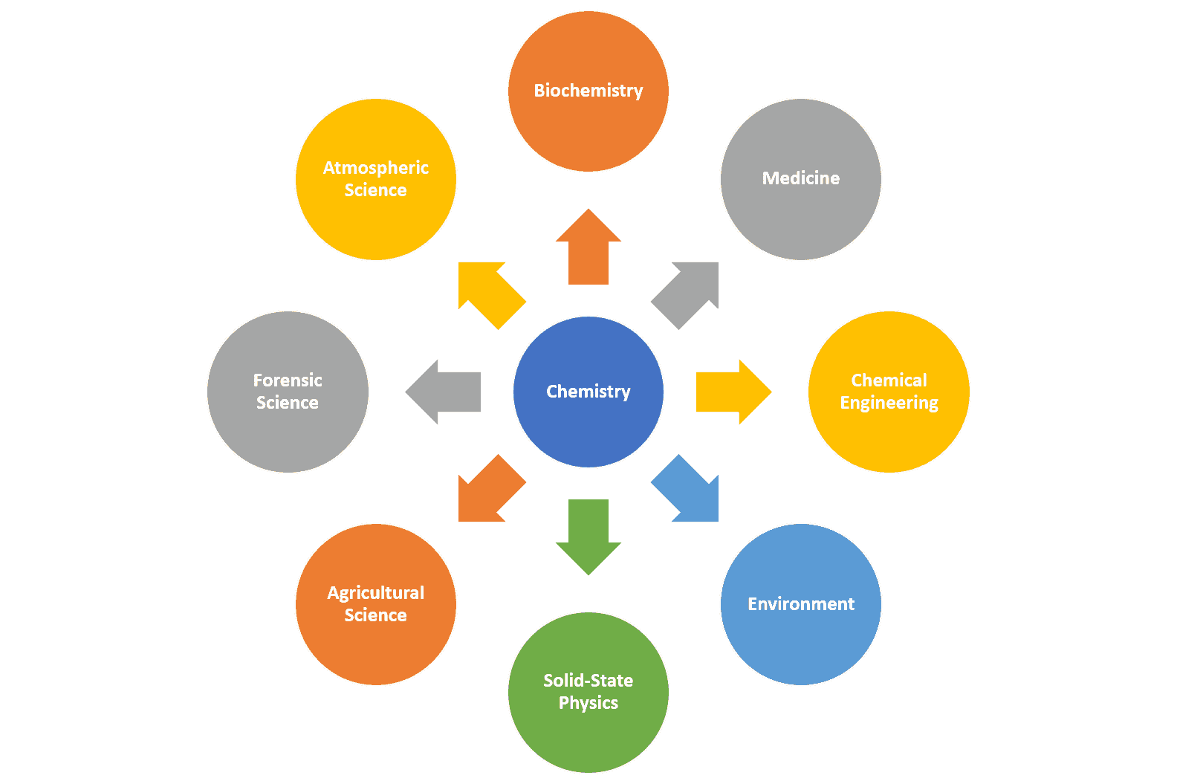

Importance of Chemistry…

Slide 8
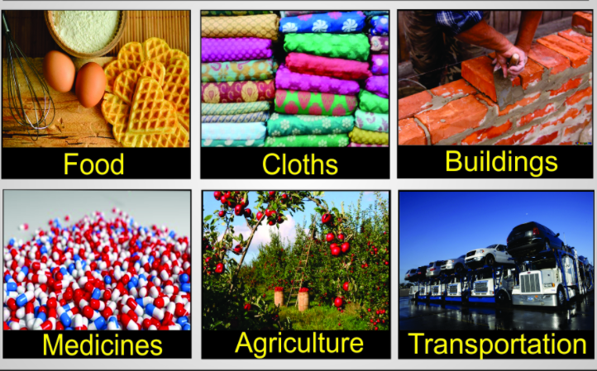

Chemistry in everyday life

Slide 9
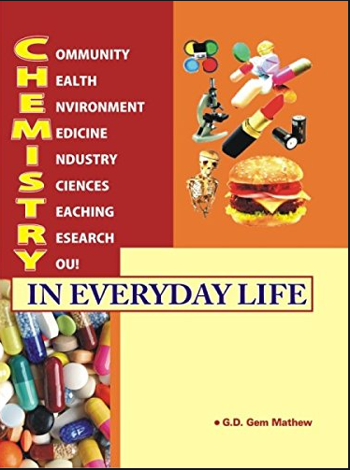
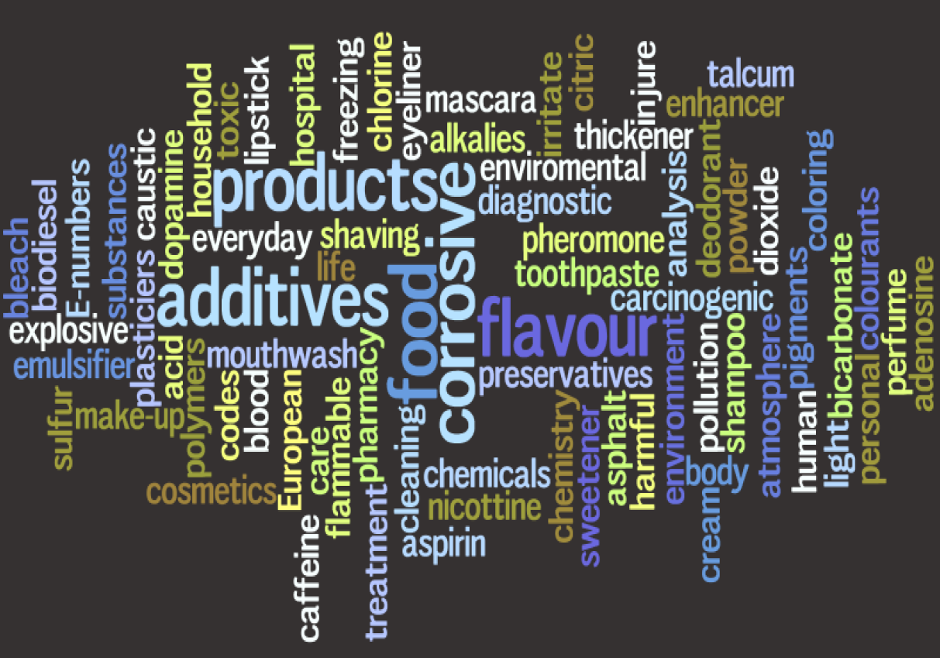
Chemistry in everyday life

Slide 10
Chemistry in everyday life
Citric acid
Food colouring
Flavour enhancer
Sweetener
Preservatives
Deodorant
Mouthwash
Toothpaste
Shaving cream
Shampoo

Slide 11
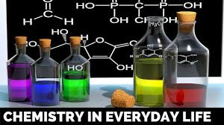

Chemistry in everyday life
Multi-purpose cleaner
Washing machine cleaner
Glass and surface cleaner
Bathroom cleaner

Slide 12
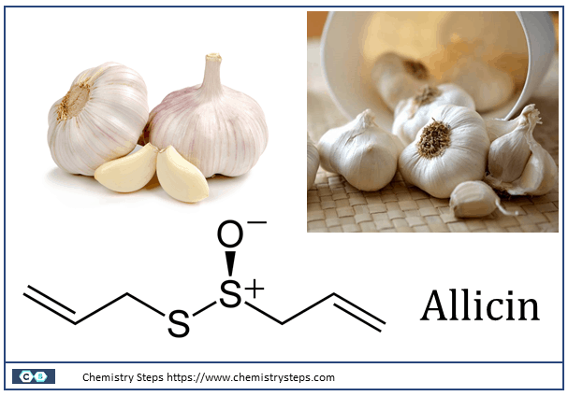
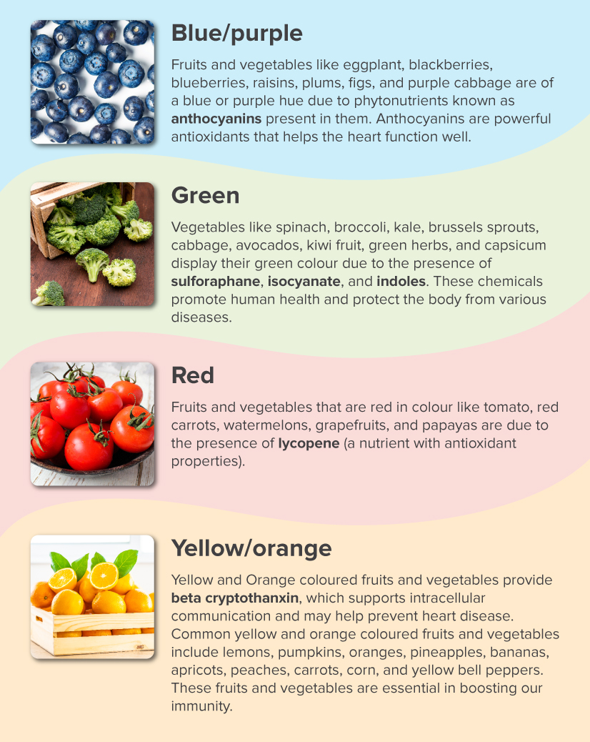
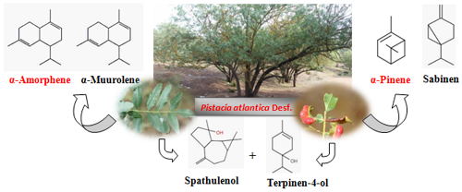
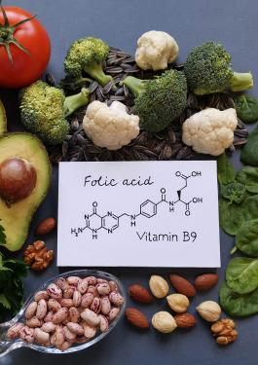
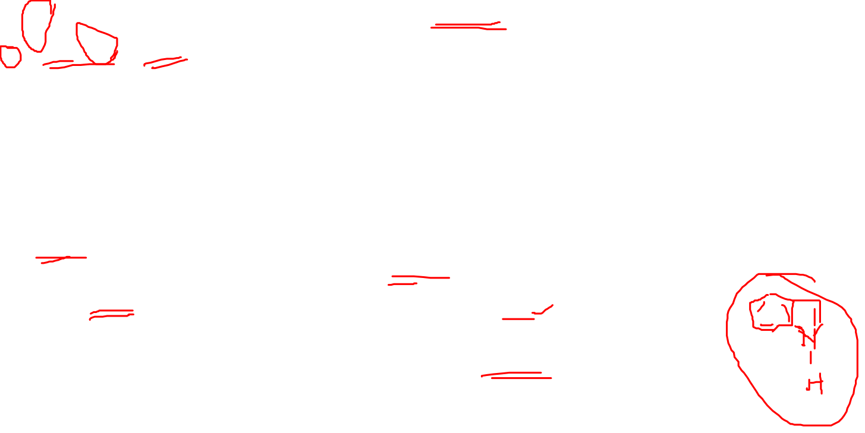
Chemistry in food…

Slide 13
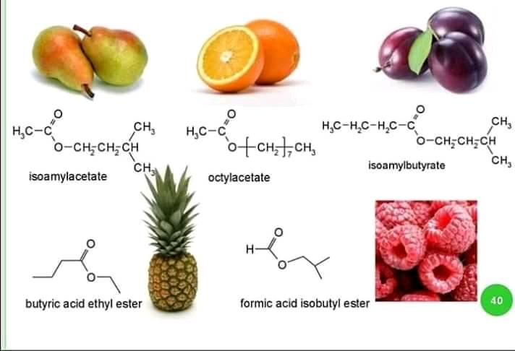
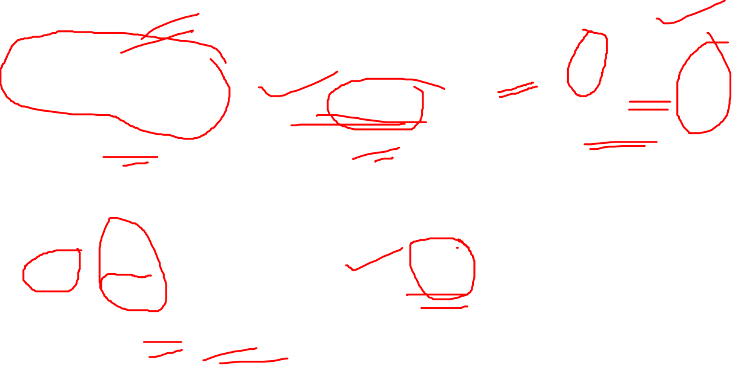
Chemistry in food…

Slide 14

Chemistry in food…
Food additives are substances added to food to
preserve flavour or improve its taste and appearance.
Some additives have been used for centuries:
eg: Salting or using sulfur dioxide as in some wines.
Several other additives have been introduced,
of both natural and artificial origin.

Slide 15
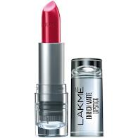

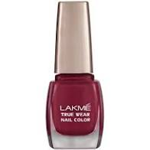

Chemistry in personal care…
Lipsticks and lip balm contains oils, beeswax and perfumes. These protect, soften and bright the lips.
Mascaras have a composition based on a volatile solvent, beeswax, pigments (iron oxide) and polymers.
Nail polish is made of lacquer, and consists of polymers, solvents, plasticisers, colourants, and perfumes.

Slide 16
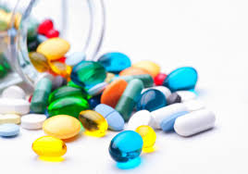
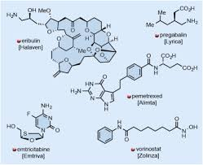
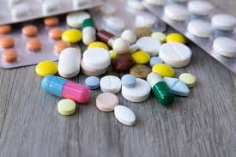

Chemistry in medicine…
Chemistry is a huge part of medicine, both as a diagnostic and treatment tool.
Chemistry departments in hospital medical labs analyze blood, urine, etc. for proteins, sugars and other substances.
Blood analysis test the amount of potassium and sodium in our blood.

Slide 17
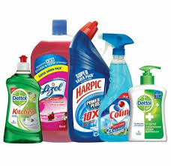
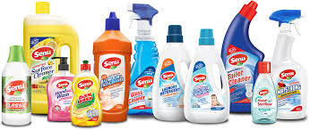

Chemistry in household cleaning …
The chemistry in household cleaning products affects our environment greatly.
For example, a very common component in cleaning products is chlorine.
Chlorine has gaseous elements that can be lethal if large quantities are released into the atmosphere.

Slide 18
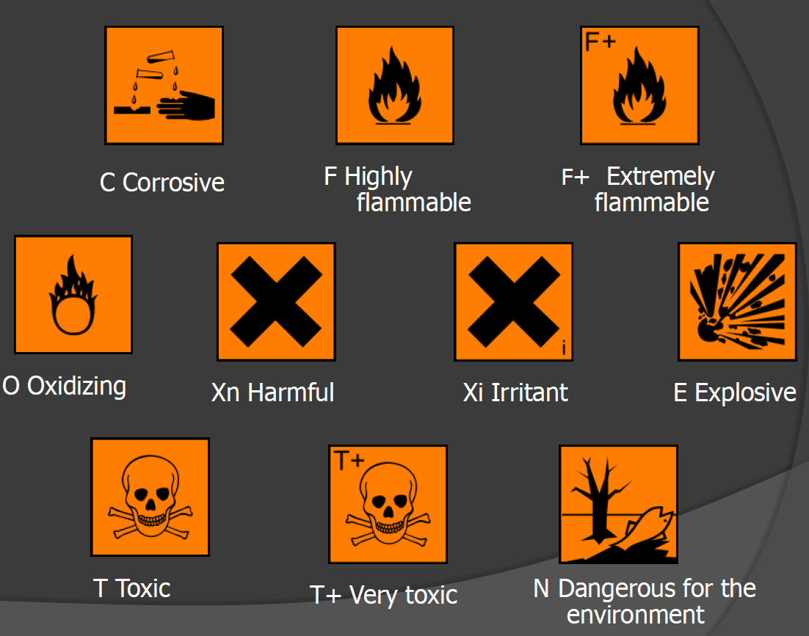

Important signs…

